Slide 1
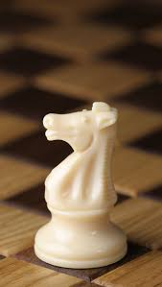
Knight's Tour
Chaitanya Bhutada : 17CS10011
Sanket Meshram: 17CS30030

Slide 2
What is ‘Knight’s Tour?
Hamiltonian Tour of a Chess knight.
Start on a Random Square.
Visit each square exactly once.
Tour can be Open/ Closed just like Hamiltonian.
Variations of knight's tour problem.
Tour on a n*m Board.
Irregular Board possibly with holes.

Slide 3
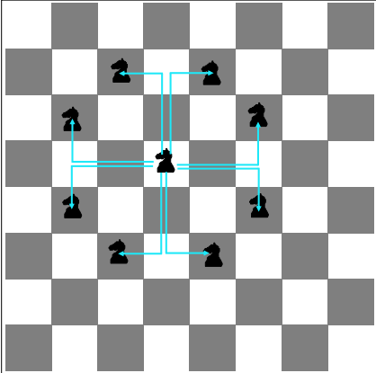
Knights Legal Moves
The Moves can be : {(-2,-1),(-2,+1),(-1,-2),(-1,+2),(+1,-2),(+1,+2),(+2,-1),(+2,+1)}
Corner case: The Knight Cannot Move out of the Chess-Board.

Slide 4
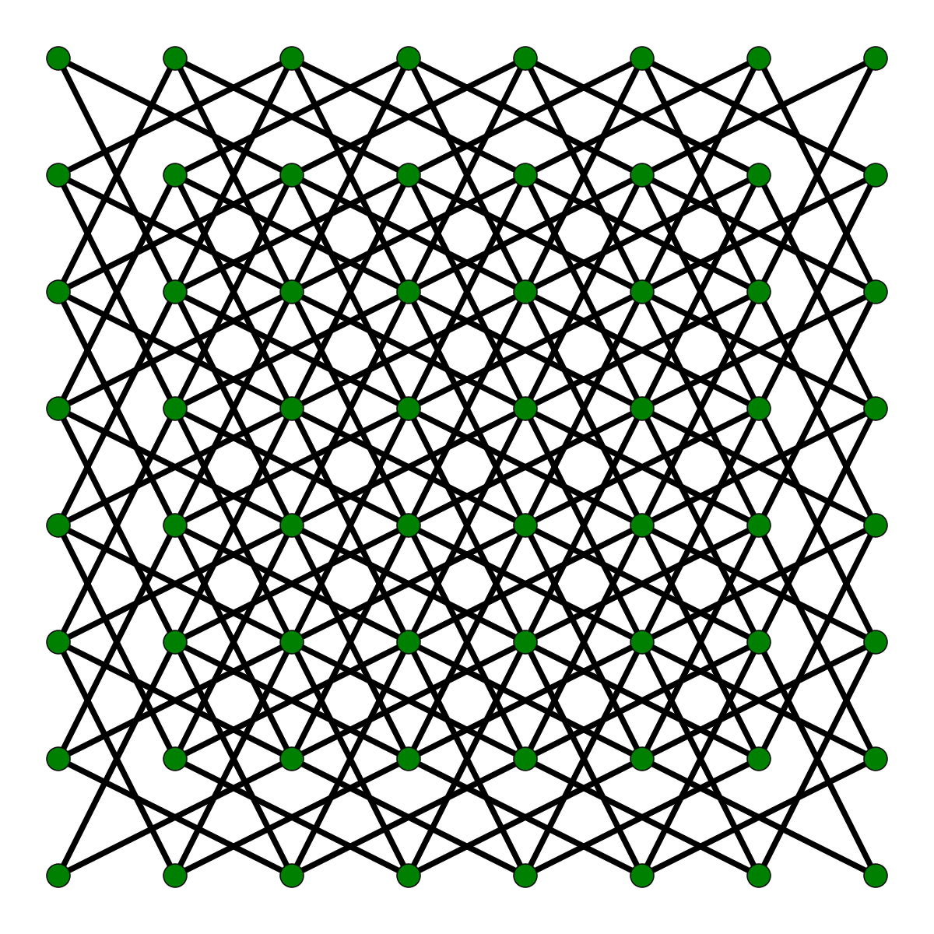
Knight's Graph
Knight's tour can be represented as a Graph.
The vertices - Represent the squares of the board.
The Edges - Represent Legal moves of the knight.
Knight's Graph is Bipartite.
The tour is instance of Hamiltonian Path.
Closed tour is instance of Hamiltonian Cycle.
Can be solved in a linear time using Heuristics.

Slide 5
Algorithms for Knight Tour

Slide 6
BackTracking Solution. (Algorithm and Analysis)
Start from a random (X,Y) position on the Chess Board.
Make a move until we reach traverse all 8*8 or n*m positions.
From the Current Position we can move to the next 8 positions.
Mark the Current Position Visited.
Move to next Position and return True if all position is traversed.
If at point we can't move to any free position and get a Possible path return False.

Slide 7
Space and Time Complexity Analysis.
Space Complexity
Marking each position visited or not.
O(n*m) n = number of rows, m = number of columns.
Time Complexity
Each Position can move to at most 8 next positions.
O(8^(n*m))
The Space complexity is linear.
Time complexity is Exponential.
Cannot use this for 8*8.

Slide 8
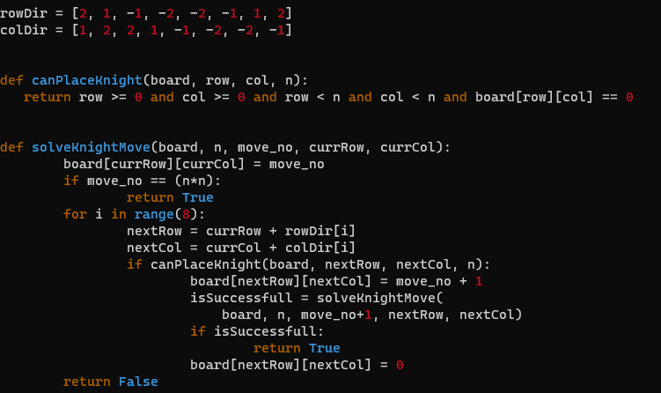
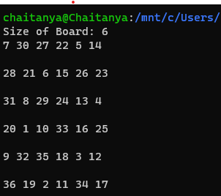
Output for 6*6.
Time taken = 510 secs.

Slide 9
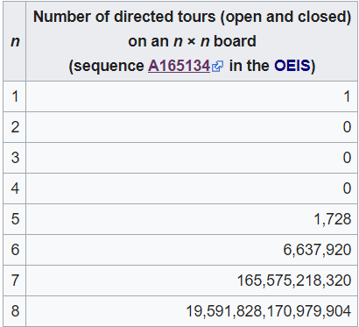
Number of Directed knight's tour increases rapidly .
Next randomized algorithm uses this fact.

Slide 10
Warnsdorff's Algorithm
Always visiting the Square which has least Accessibility.
Algorithm
set P as any random start Square.
mark P with number '1'
for each move number 2 to (n*m):
Let S be set of points accessible from P.
set P with point of least accessibility.
mark P with current move number.
The marking will return us the order of knights move.

Slide 11
Visualization
'1' is the Start Position.
The number in the boxes denotes the accessibility of that position.
Intuition behind this is that the one's which has lower accessibility would be blocked earlier.
3 |  | 7
 |  |  | 7
 | '1'
 |  |  | 7
2 |  | 5

Slide 12
Breaking Ties

Slide 13
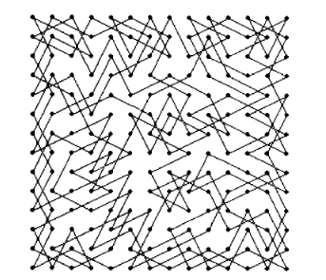
Ties in Warnsdorff
Arnd Roth's proposition
The proposition is to break the ties by choosing the successor with the largest euclidean distance from the center of the board.
Ira Pohl's proposition
Applying Warnsdorff's rule second time.
Sum of the Degrees of all unvisited neighbors, of the successors that tied, and choose the square whose sum is minimal.

Slide 14
Space and Time Complexity Analysis.
Space Complexity
Marking each position visited or not.
O(n*m) n = number of rows, m = number of columns.
Time Complexity
From a Position knight can move to one of max 8 positions.
O(8*(n*m))
The Space complexity is linear.
Time complexity is Linear.

Slide 15
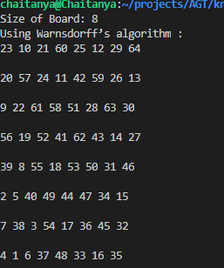
Output for 8*8.
Time taken = 0.015625 sec.
Output for 100*100.
Time taken = 0.71875 sec.

Slide 16
Neural Networks

Slide 17
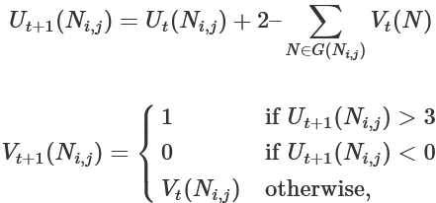
Neural Networks.
Each legal move of the Knight is represented as a Neuron.
Neuron is active (1) if it is part of the solution, inactive (0) if it is not a part of the solution.
Transition Rules:

Slide 18
Transition Rules.
Stable state is the one where the neuron has exactly two adjacent neurons.
Initially the state of each neuron is set to 0.
Output of each Neuron is set as 0/1 randomly.

Slide 19
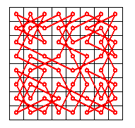
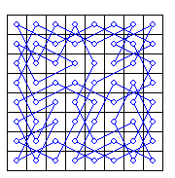
Simple Knight Tour
Can you spot the four independent circuits?
n < 20.
Iterations required <= 100.
Parberry obtained knight tour out of 40,000 trials for n = 26. Probability vanishes as n grows larger.

Slide 20
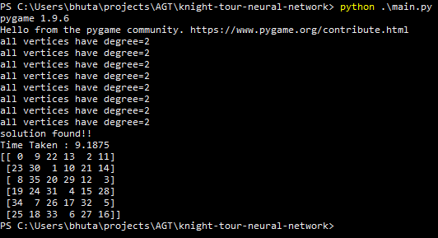
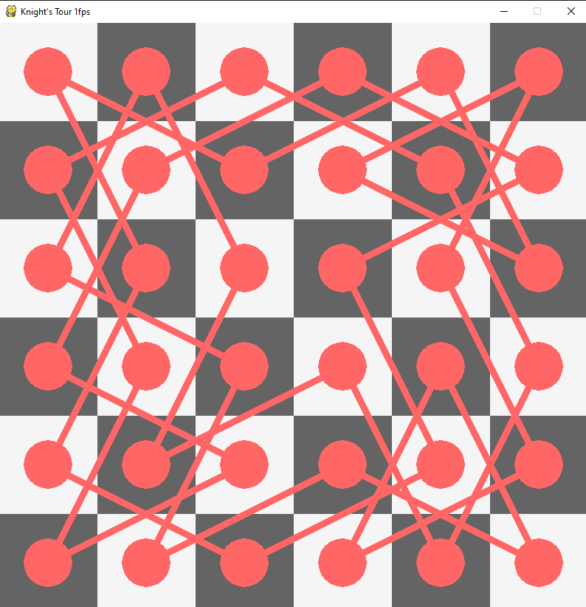

Slide 21
General Knight Tour

Slide 22
Board of Width 3
There exists a tour on a 3 × m board unless m = 3, 5, 6. m ≥3
Tour on 3x3 ,3x5,3x6 does not exist can be proved easily .

Slide 23
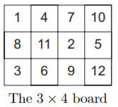
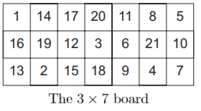
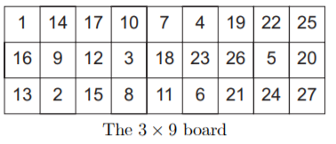
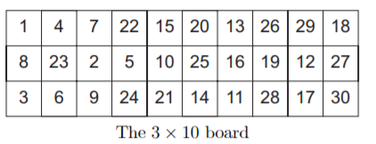
Board of Width 3

Slide 24
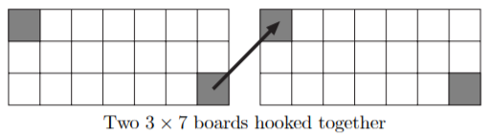
Board of Width 3
On four tours mentioned in previous slide end in the square , from which you can jump on top left square of next board .

Slide 25
Board of Width 3
11 = 7+ 4
12 = 4 + 4 +4
13 = 9 + 4
14 = 10 + 4
15 = 4 + 4 + 7
16 = 4 + 4 + 4 + 4
17 = 10 + 7
18 = 9 + 9
19 = 7 + 4 + 4 + 4
10(n+1) + k = (n*10) + (10 + k ) ; 10+k can be replaced from above .

Slide 26
Board of Width 4
The grey squares can be toured on a 4 × m board for m ≥ 5.

Slide 27
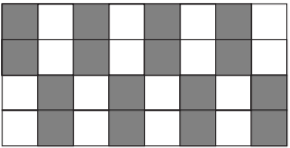
Board of Width 4
Divide the board into colour white and grey .
Make first two in first column grey and next 2 as white or vise versa .
Then keep alternating on next columns.

Slide 28
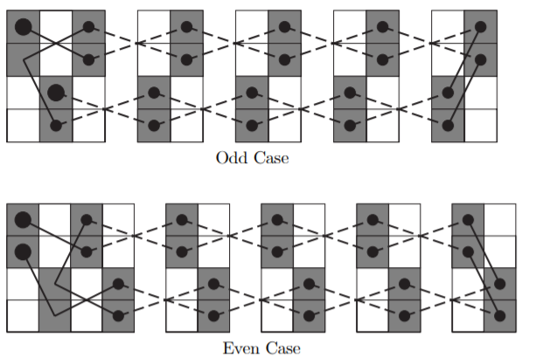
Board of Width 4
Tour on Grey squares .

Slide 29
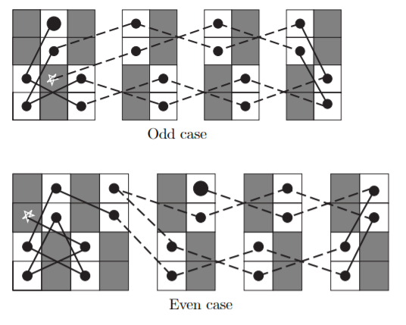
Board of Width 4
Tour on white squares.
Star represent square where Tour on Grey squares end .

Slide 30
References
1] SAM GANZFRIED
2] https://www.slac.stanford.edu/pubs/slacpubs/0250/slac-pub-0261.pdf
3] http://www.cs.kent.edu/~dragan/ST-Spring2016/Knights%20Tour%20Graphs.pdf

Slide 31
Q & A

